Slide 1
Access to HPC System

Slide 2
Who and How Obtains the Access?
After contacting the NCC, you will be directed to one of the HPC centres that matches your needs.
The procedure with which the access to HPC systems is granted varies for users from academia, public sector, SMEs and industry.
You can obtain the access to an HPC system for a certain number of core-hours.
A system is used by submitting jobs which are processed on the requested resources once they are available.
The jobs can be submitted through user interfaces:
JupyterLab
Command line using ssh
Graphical user interface.
Users from academia or public sector
Public funding
Submit a proposal for a GCS or PRACE project
Pay per amount of core-hours
Users from SMEs or industry
Publicly funded time limited industry related projects (e.g., FF4EuroHPC)
Proposal and confidential final report
Submit the job
Collaboration with academia
Publish results
Job is queued until the resources are available
Monitor the job
How to Use an HPC System?
Job is processed with the requested resources (computing nodes / cores, duration etc.)

Slide 3
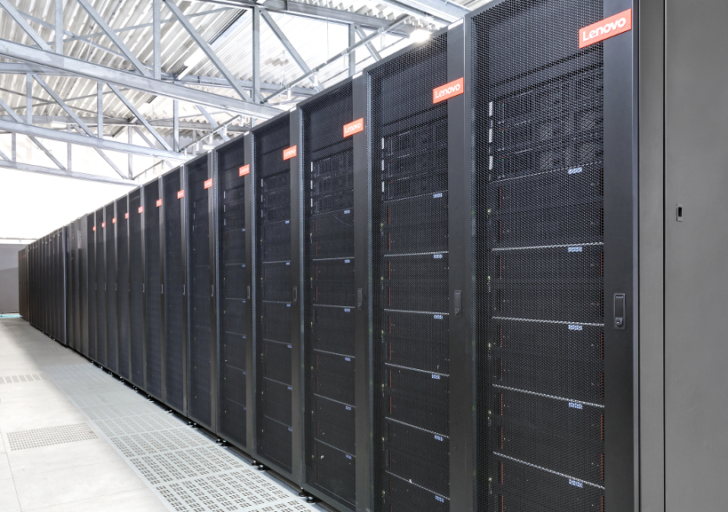
Data Management

Slide 4
User specific data
(ssh-keys, general source code)
$HOME
- Backup of data on most systems
Data Management
In HPC-projects typically large amounts of data are created. To optimize the performance various stor-age systems exist which are meant to be used at different stages of the workflow of a project. An example of the handling of data within the work-flow of one project is shown on the left. Here, the data is located on the home-, scratch-, project-, and archive-storage sys-tems. The special proper-ties of the storage sys-tems is briefly indicated.
Computation I/O
$ARCHIVE
- Long-time storage
$SCRATCH
- High bandwidth optimized for I/O
- Temporary data
- Frequent automatic file deletion
Archive your data
Share data in your project
$PROJECT
- Backup depends on system
Limited Storage
old files need to be cleaned up frequently
Limited number of files
multiple files need to be compressed to single file archives (.tar)

Slide 5
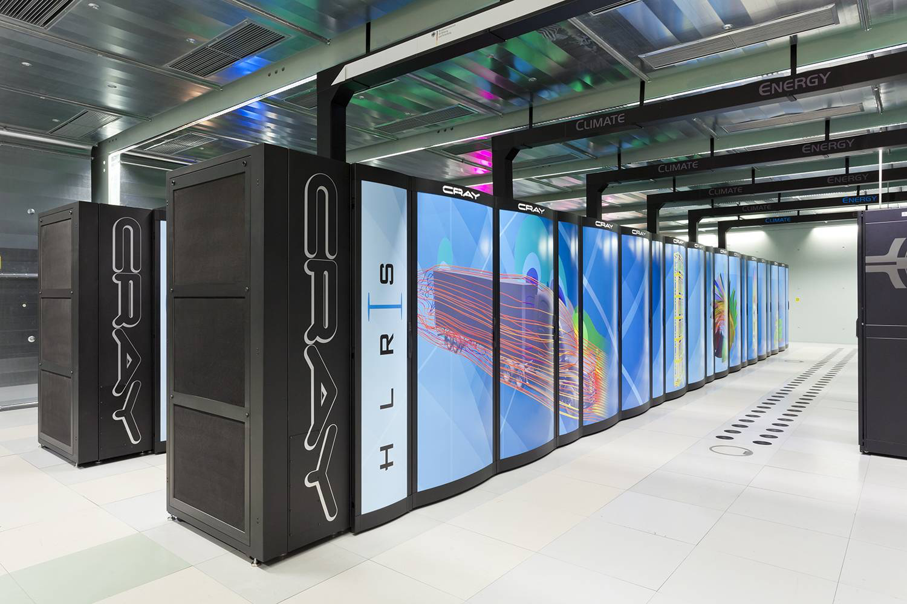
Software

Slide 6
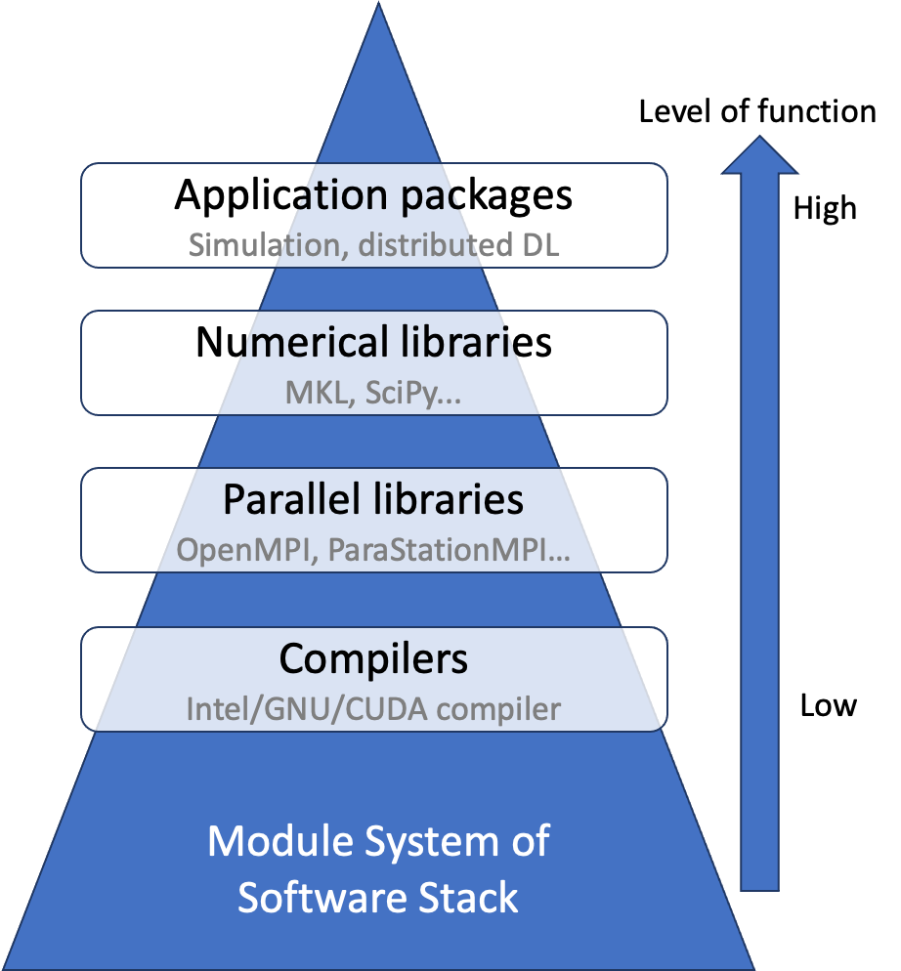
Software
HPC centers make efforts to provide structured software stack that is optimized for the respective systems. For convenient deployment, the software stack is delivered to users through a module system.
In addition, debugger and performance analysis tools are offered to facilitate code development and optimiza- tion, as well as simulation codes that are optimized in scalability and efficiency for heterogenous HPC systems.
GNU Debugger
Debugger & Performance Tools
Module Management
Broad software portfolio available on HPC systems, including lower-level compilers and parallel program-ming libraries, to higher-level numerical libraries and scientific application packages
Various scalable simulation code and distributed machine learning packages

Slide 7
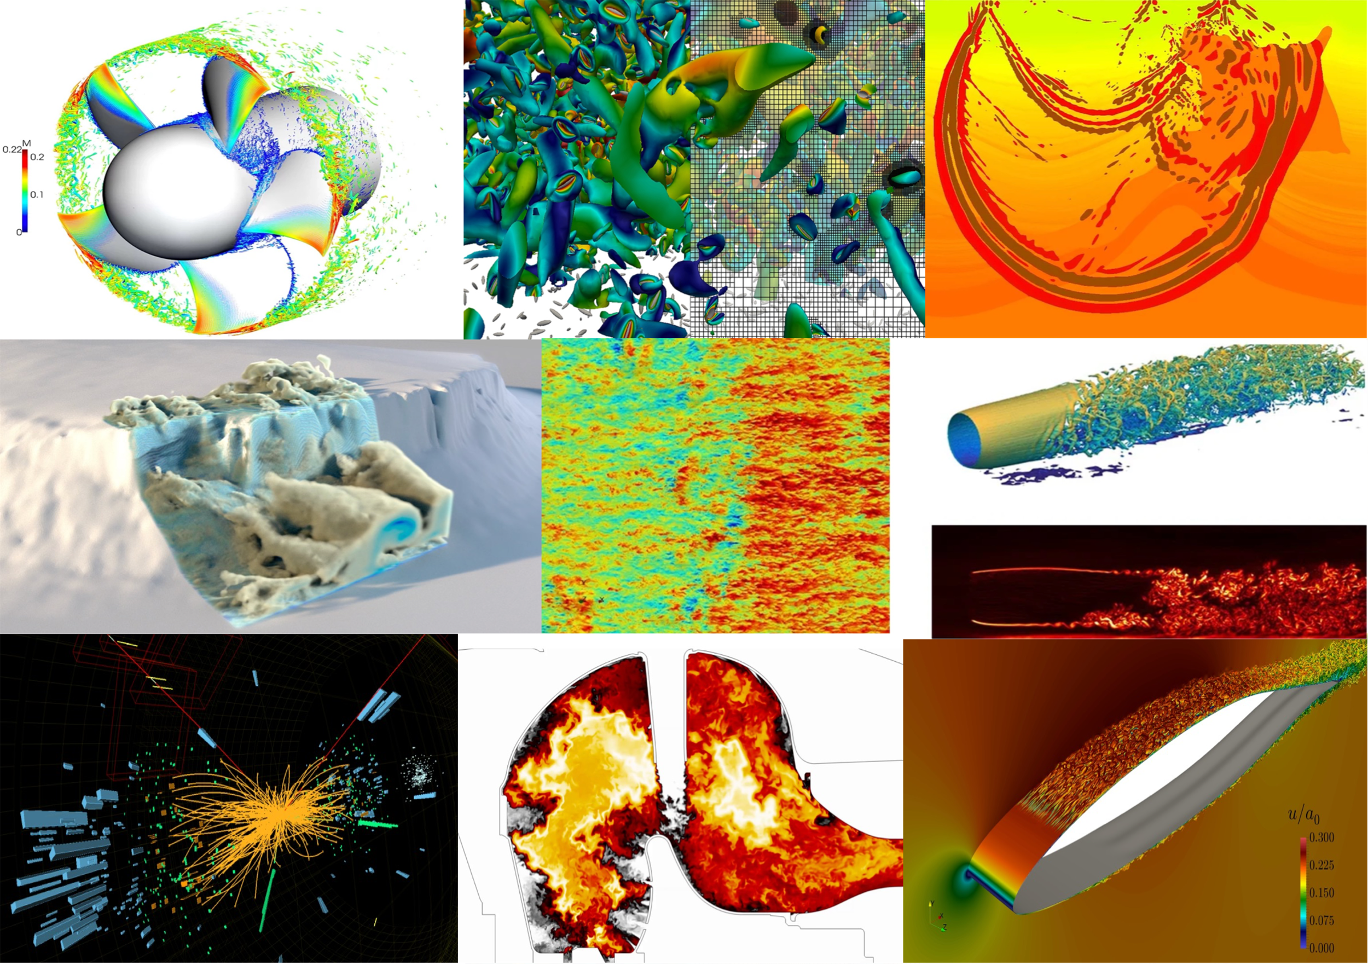
Visualization

Slide 8
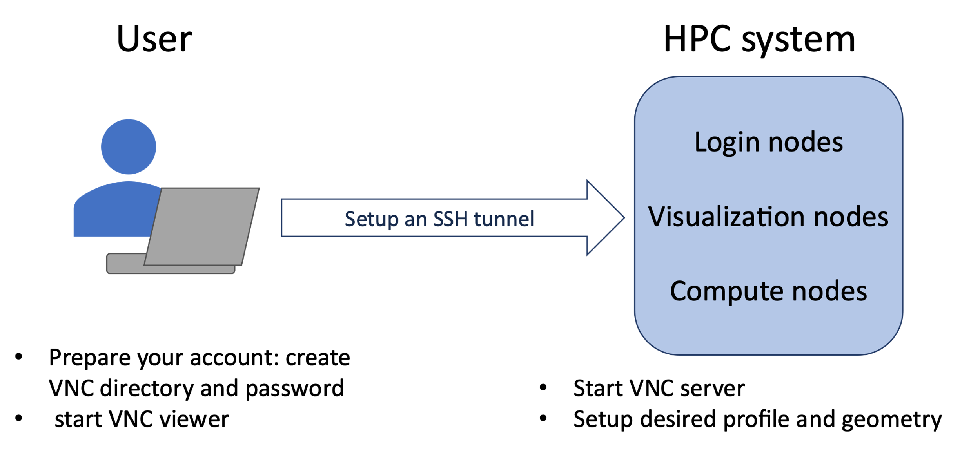
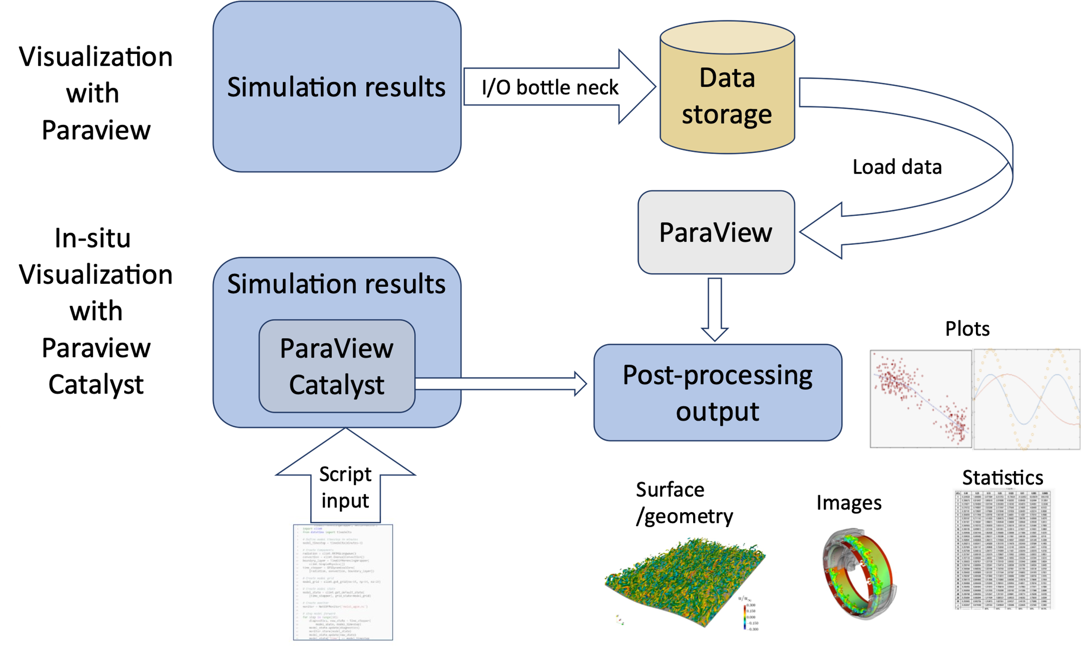
Visualization
Visualization nodes assist data postprocessing and ren-dering on supercomputers. A graphical login can be estab-lished trough a VNC connec-tion to access data stored on the file system.
HPC users can run in-situ visualization to avoid off-site data transfer and increase efficiency in post-processing and interpretation. A Typical workflow is shown using Paraview Catalyst as an example. The benefit of time saving is more apparent for larger simulations and helps users to take full advantage of the computing resources.

